Slide 1
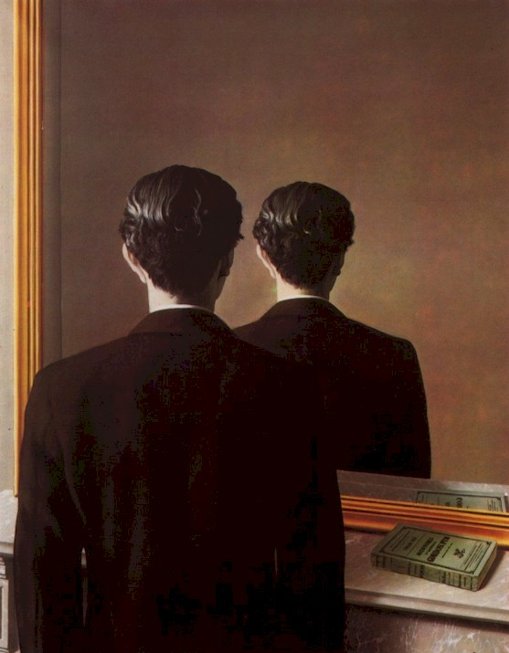
3D Modeling for a Single View
René MAGRITTE
Portrait d'Edward James
CS180: Intro to Comp. Vision and Comp. Photo
Alexei Efros, UC Berkeley, Fall 2024
…with a lot of slides stolen from
Steve Seitz and David Brogan,

Slide 2

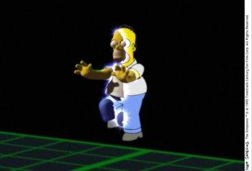
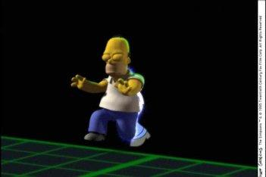
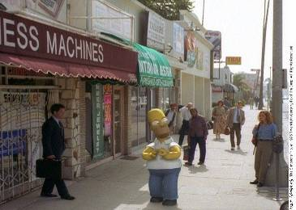
Breaking out of 2D
…now we are ready to break out of 2D
And enter the real world!

Slide 3

on to 3D…
Enough of images!
We want more of the plenoptic function
We want real 3D scene
walk-throughs:
Camera rotation
Camera translation
Can we do it from a single photograph?

Slide 4
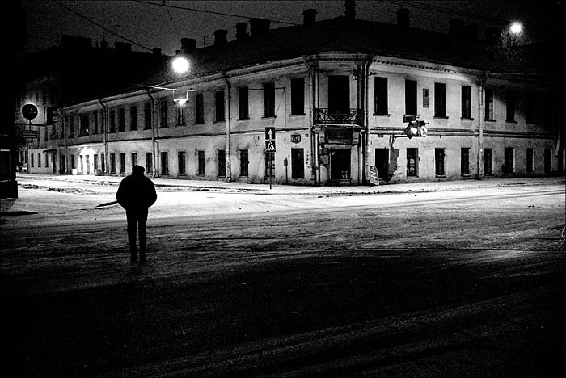
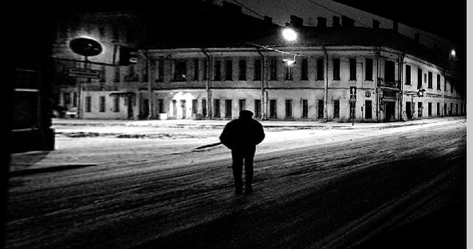
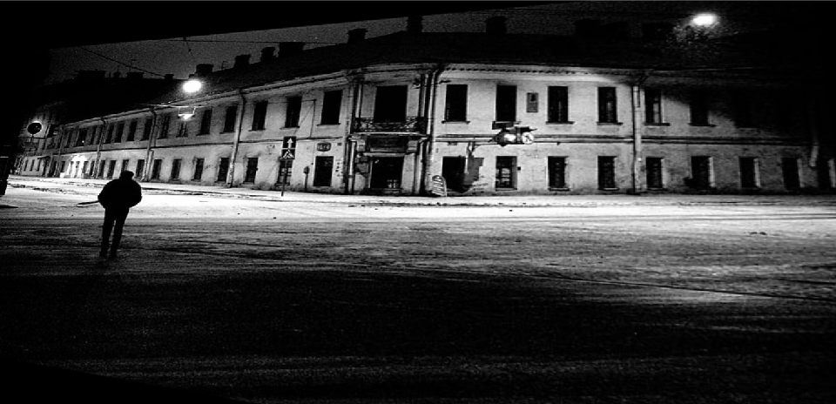
Camera rotations with homographies
Original image
St.Petersburg
photo by A. Tikhonov
Virtual camera rotations

Slide 5
Camera translation
Does it work?
synthetic PP
PP1
PP2

Slide 6
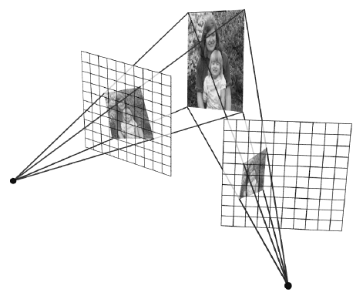
Yes, with planar scene (or far away)
PP3
PP1
PP2
PP3 is a projection plane of both centers of projection, so we are OK!

Slide 7
So, what can we do here?
Model the scene as a set of planes!
Now, just need to find the orientations of these planes.

Slide 8

Automatic Photo Pop-up
Notes:
Possibly end with this

Slide 9
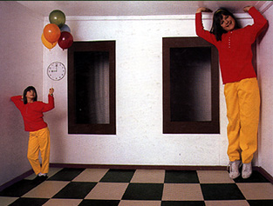
Some preliminaries: projective geometry
Ames Room

Slide 10

Silly Euclid!
Parallel lines???

Slide 11
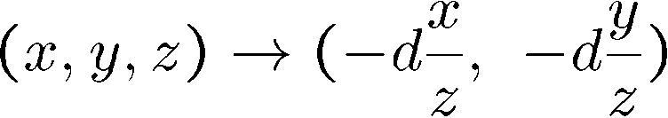
The projective plane
Why do we need homogeneous coordinates?
represent points at infinity, homographies, perspective projection, multi-view relationships
What is the geometric intuition?
a point in the image is a ray in projective space
y
(sx,sy,s)
(x,y,1)
(0,0,0)
z
x
image plane
Each point (x,y) on the plane is represented by a ray (sx,sy,s)
all points on the ray are equivalent: (x, y, 1) ≅ (sx, sy, s)
Remember projection eq:

Slide 12
Projective lines
What does a line in the image correspond to in projective space?
A line is a plane of rays through origin
all rays (x,y,z) satisfying: ax + by + cz = 0
l
p
A line is also represented as a homogeneous 3-vector l

Slide 13
Point and line duality
A line l is a homogeneous 3-vector
It is ⊥ to every point (ray) p on the line: l p=0
p₁
p₂
l₁
p
l
l₂
What is the line l spanned by rays p₁ and p₂ ?
l is ⊥ to p₁ and p₂ ⇒ l = p₁ × p₂
l is the plane normal
What is the intersection of two lines l₁ and l₂ ?
p is ⊥ to l₁ and l₂ ⇒ p = l₁ × l₂
Points and lines are dual in projective space
given any formula, can switch the meanings of points and lines to get another formula

Slide 14
Ideal points and lines
y
(sx,sy,0)
z
image plane
x
Ideal point (“point at infinity”)
p ≅ (x, y, 0) – parallel to image plane
It has infinite image coordinates
Ideal line
l ≅ (0, 0, 1) – parallel to image plane

Slide 15
Vanishing points
image plane
vanishing point
camera
center
ground plane
Vanishing point
projection of a point at infinity

Slide 16
Vanishing points (2D)
image plane
vanishing point
camera
center
line on ground plane

Slide 17
Computing vanishing points
V
P₀
D
Properties
P∞ is a point at infinity, v is its projection
They depend only on line direction
Parallel lines P₀ + tD, P₁ + tD intersect at P∞

Slide 18
Vanishing points
image plane
vanishing point V
camera
center
C
line on ground plane
line on ground plane
Properties
Any two parallel lines have the same vanishing point v
The ray from C through v is parallel to the lines
An image may have more than one vanishing point

Slide 19
Vanishing lines
v₁
v₂
Multiple Vanishing Points
Any set of parallel lines on the plane define a vanishing point
The union of all of these vanishing points is the horizon line
also called vanishing line
Note that different planes define different vanishing lines

Slide 20
Vanishing lines
Multiple Vanishing Points
Any set of parallel lines on the plane define a vanishing point
The union of all of these vanishing points is the horizon line
also called vanishing line
Note that different planes define different vanishing lines

Slide 21
Computing vanishing lines
C
l
ground plane
Properties
l is intersection of horizontal plane through C with image plane
Compute l from two sets of parallel lines on ground plane
All points at same height as C project to l
points higher than C project above l
Provides way of comparing height of objects in the scene

Slide 22

Notes:
Is this parachuter higher or lower than the person taking this picture?
Lower—he is below the horizon

Slide 23
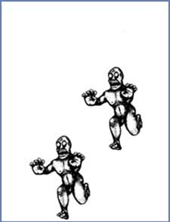
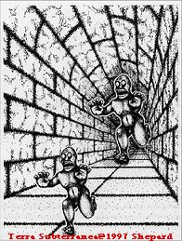
Fun with vanishing points

Slide 24
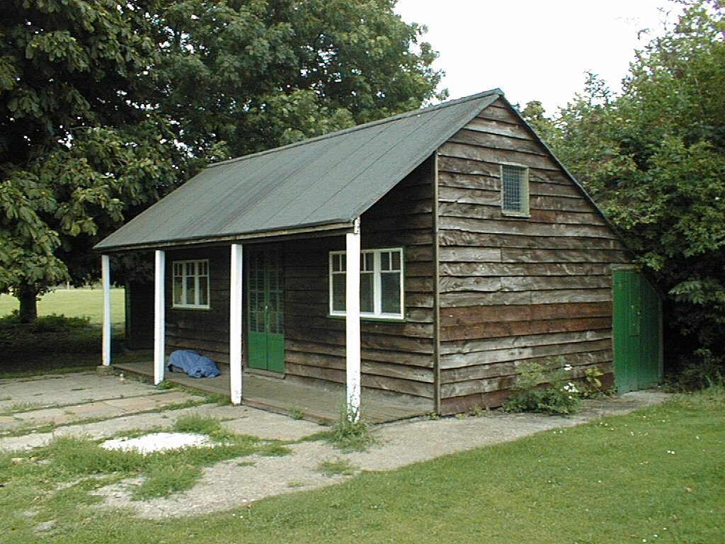
3D from single image
Find world coordinates (X,Y,Z) for a few points
Connect the points with planes to model geometry
Texture map the planes

Slide 25
Finding world coordinates (X,Y,Z)
Define the ground plane (Z=0)
Compute points (X,Y,0) on that plane
Compute the heights Z of all other points

Slide 26
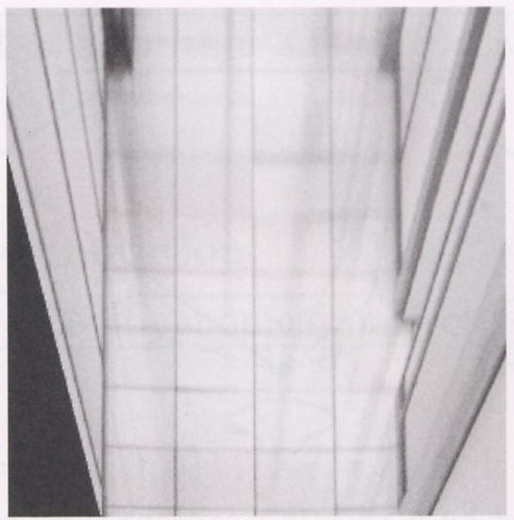
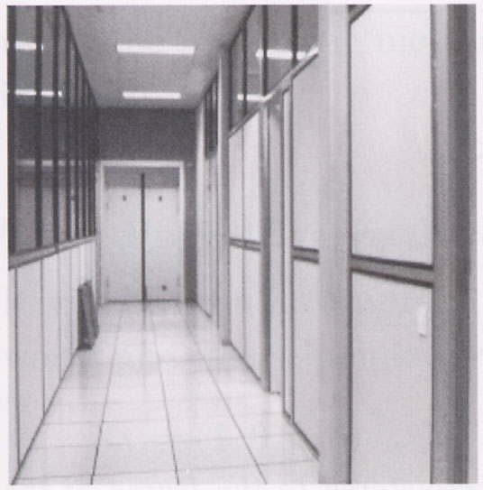
Measurements on planes
4
3
2
1
1
2
3
4
Approach: unwarp, then measure
What kind of warp is this?
Notes:
homography!

Slide 27
Unwarp ground plane
x
p’
p
Our old friend – the homography
Need 4 reference points with world coordinates
p = (x,y)
p’ = (X,Y,0)

Slide 28
Finding world coordinates (X,Y,Z)
Define the ground plane (Z=0)
Compute points (X,Y,0) on that plane
Compute the heights Z of all other points

Slide 29
Comparing heights

Slide 30
Perspective cues

Slide 31
Perspective cues

Slide 32
Criminisi ’99
Vertical vanishing
point
(at infinity)
Vanishing
line
Vanishing
point
Vanishing
point

Slide 33
Comparing heights
Vanishing
Point

Slide 34
Measuring height
5.4
5
Camera height
4
3.3
3
2.8
2
1

Slide 35

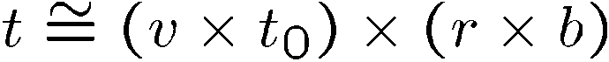

Measuring height
v_{z}
r
vanishing line (horizon)
t₀
t
v_{x}
v
v_{y}
H
R
H
b₀
b

Slide 36
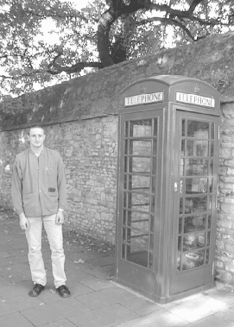
Measuring heights of people
Here we go !
185.3 cm
reference

Slide 37
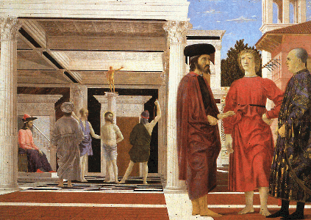
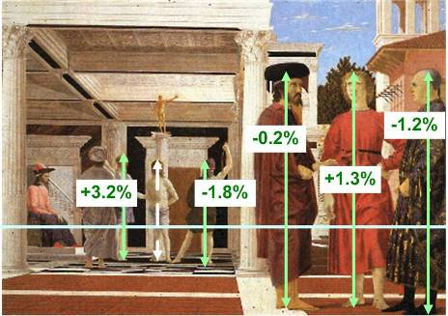
Assessing geometric accuracy
Are the heights of the 2 groups of people
consistent with each other?
Flagellation,
Piero della Francesca
Estimated relative heights

Slide 38
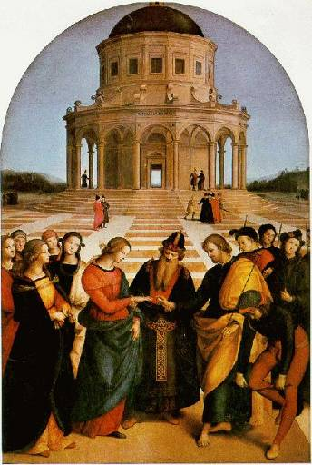
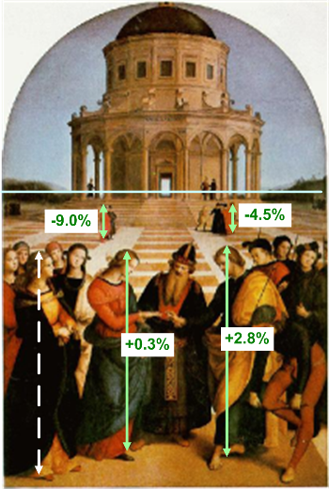
Assessing geometric accuracy
The Marriage of the Virgin, Raphael
Estimated relative heights

Slide 39
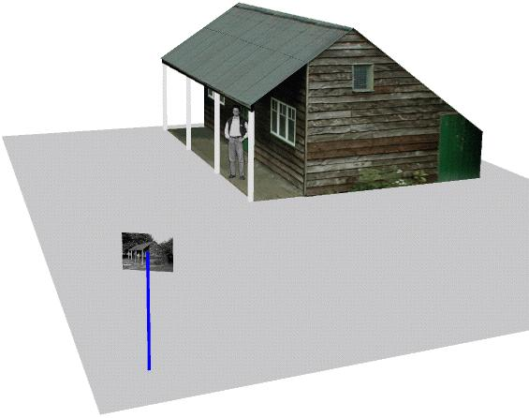
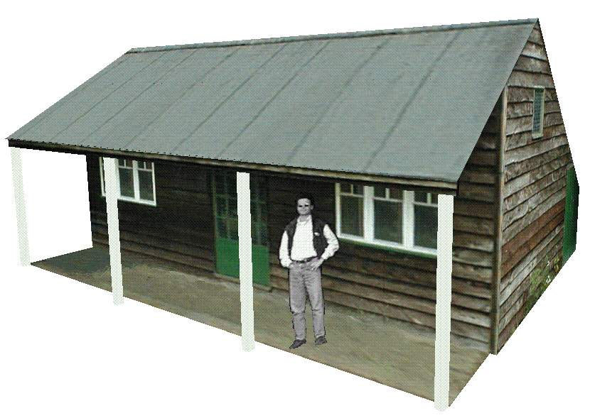
Complete 3D reconstruction
Single
View
algorithms
Planar measurements
Height measurements
Automatic vanishing point/line computation
Interactive segmentation
Occlusion filling
Object placement in 3D model
Single
image
3D
model

Slide 40

A virtual museum @ Microsoft
Thanks
A.Criminisi http://research.microsoft.com/~antcrim/

